Slide 1
Diagrams
EDC&I 583
Message Design
1 February 2012

Slide 2
Plan of Action 2/1/12
Happy Imbolc!
Good and bad examples
Discuss Reviews of Literature
Presentation on Diagrams
Redesign presentations
Discussion of readings

Slide 3
HAPPY GROUNDHOG DAY! (Tomorrow, 2/2)
In Celtic/Gaelic mythology, February 1 is also Imbolc
(From “In belly,” referring to lambs that would be born in the Spring)
It’s a cross-quarter day (midway between Winter Solstice and Spring Equinox)
What are the other cross-quarter days? Do we still note them?

Slide 4
Literature Review - Discussion
Did you find good things?
Did you find what you hoped you’d find?
Did you not find things you thought you would?
Did you find unexpected good things?
Problems identifying appropriate sources?
(Journals, web sites, etc.)
How did you judge quality of what you found?

Slide 5
Diagrams
Tell a small story in compressed form
How something works
How something is put together
What do interior/invisible parts look like
How something changes over time
Conceptual connections
Reveal unsensed underlying sense (?!)

Slide 6
How Something Works
An escalator

Slide 7
How Something Is Put Together
A Nokia phone

Slide 8
How to Put Something Together
Infamous and ubiquitous IKEA instructions!
Development of a universal visual-verbal language?
Cf. Robert Horn’s Information Mapping approach

Slide 9
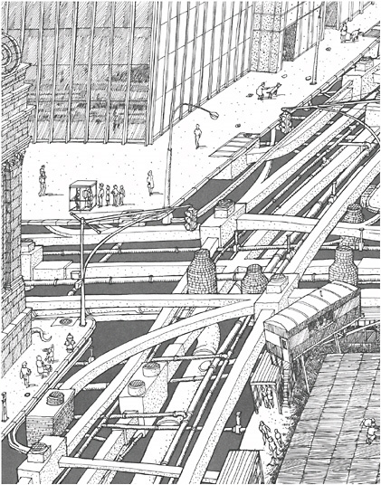
What Do Interior/Invisible Parts Look Like
David Macaulay’s Underground
Construction details
Interior configuration of rooms, elements, parts
“A view from where we cannot stand”

Slide 10
How Something Changes over Time
Glacier cover
(cf. Fathulla and Basden’s “surface coverage”)

Slide 11
Conceptual Connections
From Tufte’s Beautiful Evidence

Slide 12
Conceptual Connections (…are not always clear; from a 2010 US Army briefing)

Slide 13
Reveal Unsensed Underlying Sense
?
What should go here?

Slide 14
How Do We Interpret These?
Some aspects of interpreting are intuitive
Cut-away views
Line-art representations (“comic book” like)
Others have to be learned
Spatial relationships
Time flow
What “up” and “down” mean
Proximity-distance relationships

Slide 15
Some General Problems
“Chartjunk” (Tufte’s expression)
Graphics that don’t materially add to understanding
Lots of flashy graphic effects for the sake of effects
Often confusing and/or just disturbing to look at!

Slide 16
But…
Is ChartJunk necessarily all bad?
Tufte hated this infographic from a 2003 NY Times article
But… readers thought it was pretty good!

Slide 17
Steinberg’s Country Noises
Just for fun…
Not a diagram; maybe a textogram? Or a symbologram?

Slide 18
Questions for Discussion
How could you apply the “Sketch understanding” approach to a real-world problem in learning? (Assuming functional software)
Can you recall particular cases where you tried to use a diagram to communicate, and succeeded/failed? What made it work/not?
Newsletter design (RW): Your experiences in designing newsletters? Effectiveness of RW’s approaches?
What’s the place for newsletters in an all-web world? (Do we need to communicate in new ways?)

